Slide 1
Artificial Intelligence (Machine Learning & Deep Learning)
{
Functions, Variable Scope & Exception Handling
}
...

Slide 2
{
..
"No matter how many mistakes you make or how slow you progress, you are still way ahead of everyone who isn't trying." – Tony Robbins
}
..

Slide 3
Contents of Day 6
Conditional Execution & Loops
Recap & introduction | Review of Python Control Flow (Loops & Conditionals) & Motivational Lecture.
Core Thoery | Understanding Functions, Variable Scope, Lambda expressions, Map/Filter, and Inner functions.
Lab Practice | Practical coding tasks implementing custom functions, variable scope, and lambda expressions.
Advance Lab | Managing files (File Handling) and handling errors gracefully (Exception Handling).
Wrap-up & Q&A | Debugging tips for functions and setting up for Object-Oriented Programming (OOP).
Important: Use of AI for solving given task is now allowed. Cellphones must be put on silent.

Slide 4
Today Objective - Functions & Scope
Why Functions matters ? In AI and Machine Learning, you will perform the same data cleaning tasks millions of times. Functions prevent you from writing the same code over and over, making your AI pipeline clean, readable, and fast.
Imagine a huge car factory. You don't build a car from scratch in one single room. Instead, you have different machines (stations). One machine installs doors. Another paints the car. In Python, Functions are those machines. You write the code for a specific task once, and then you can reuse that "machine" whenever you need it without rewriting the code!
}
..

Slide 5
Core Concept (Definition & Rules)
{
Definition:
Functions & Variable Scope
Rules:
A function is a block of organized, reusable code that only runs when it is called. "Scope" determines where a variable can be seen or used (Local vs. Global)
Why we use it:
To divide a complex ML program into smaller, manageable chunks.
Always define a function using the def keyword before you call it. Be careful not to overwrite Global variables inside a Local function scope.
Real-world AI Application: A custom function def normalize_pixels(image): used to process every image before feeding it to a Neural Network.
}
*

Slide 6
Core Concept (Definition & Rules)
{
Why we use it:
When we need a simple, throwaway function for a short period, especially inside other functions like Map or Filter.
Definition:
Lambda Expressions
A Lambda function is a small anonymous function (function without a name). It can take any number of arguments, but can only have one expression. No return keyword and only one expression allowed.
Syntax=> lambda arguments : expression
👉 Normal function:
def add(a, b): return a + b
👉 Lambda function:
lambda a, b: a + b
Why not / Rules to follow:
Do not use Lambda for complex logic. If it takes more than one line of code, use a standard def function for readability
}
*
add = lambda a, b: a + b print(add(3, 5)) # Output: 8

Slide 7
Core Concept (Definition & Rules)
{
Why we use it:
They are highly optimized tools for transforming large arrays of data quickly without writing manual for loops.
Definition:
Map and Filter
map() applies a specific function to every item in a list.
# Example 1: Square all numbers
numbers = [1, 2, 3, 4, 5]
squared = list(map(lambda x: x ** 2, numbers))
print(squared) # [1, 4, 9, 16, 25]
filter() extracts items from a list that meet a specific true/false condition.
# Example 1: Filter even numbers
numbers = [1, 2, 3, 4, 5, 6, 7, 8]
evens = list(filter(lambda x: x % 2 == 0, numbers))
print(evens) # [2, 4, 6, 8]
Why not / Rules to follow:
Do not use Lambda for complex logic. If it takes more than one line of code, use a standard def function for readability
}
*

Slide 8
Core Concept (Definition & Rules)
{
Definition:
File Handling
File handling is the process of using Python to open, read, write, append, and close external files
(like .txt, .csv, or .json) stored on your computer.
Why we use it:
AI models don't rely on data typed directly into the code. We use file handling to load massive datasets into our machine learning pipelines and to save our final predictions or model weights back to the hard drive.
Why not / Rules to follow:
Always close a file after you are done with it using .close(). Leaving files open can cause memory leaks and crash your environment. Best practice: Use the with open(...) statement, as it automatically closes the file for you even if an error occurs.
}
*

Slide 9
Core Concept (Definition & Rules)
{
Definition:
Exception Handling
Exception handling (try, except, finally) allows your program to deal with unexpected errors without crashing.
# else - runs if no error occurs
try:
num = int(input("Enter a number: "))
result = 100 / num
except ValueError:
print("Invalid input!")
except ZeroDivisionError:
print("Can't divide by zero!")
else:
# Runs only if no exception occurred
print(f"Success! Result: {result}")
finally:
# Always runs, whether error or not
print("This runs every time")
Why we use it:
AI models often ingest messy, unpredictable real-world data. If a model encounters a missing file or a string instead of a number, it shouldn't crash the whole system.
}
Why not / Rules to follow:
except: block. Always catch specific errors (like ValueError, IndexError, TypeError, KeyError or FileNotFoundError and these are Common Built-in Exceptions) so you know exactly what went wrong.
*

Slide 10
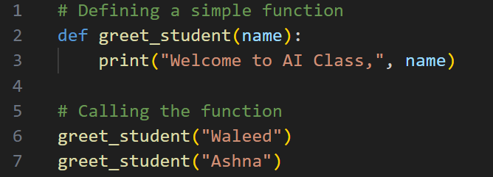
Practical exercise 01
Lab Task 1 – function
*

Slide 11
Custom Exceptions practice
# Create your own exception class
class InsufficientFundsError(Exception):
"""Raised when account balance is insufficient"""
pass
class BankAccount:
def __init__(self, balance=0):
self.balance = balance
def withdraw(self, amount):
if amount > self.balance:
raise InsufficientFundsError(
f"Cannot withdraw ${amount}. Balance: ${self.balance}"
)
self.balance -= amount
return self.balance
# Using custom exception
account = BankAccount(100)
try:
account.withdraw(150)
except InsufficientFundsError as e:
print(f"Transaction failed: {e}")

Slide 12
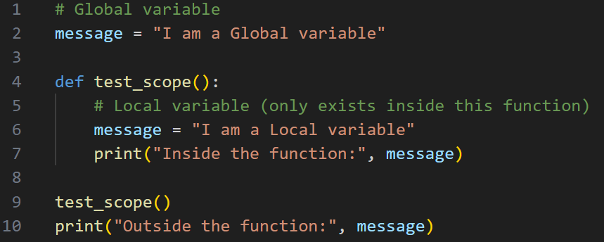
Practical exercise 02
Lab Task 2 – Global & Local Variables
*

Slide 13
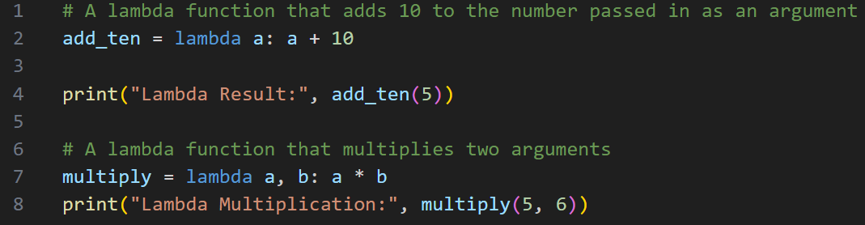
Practical exercise 03
Lab Task 3 – Lambda Expressions
*

Slide 14
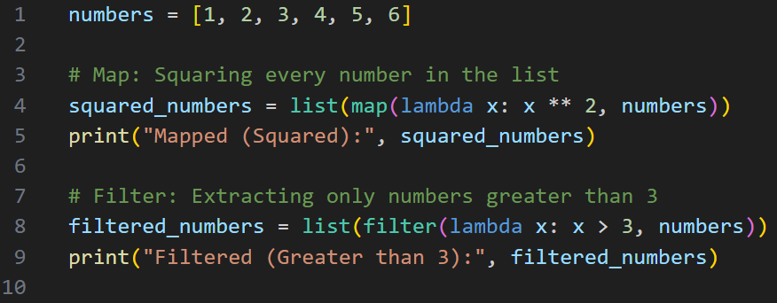
Practical exercise 04
Lab Task 4 – Map & Filter
*

Slide 15
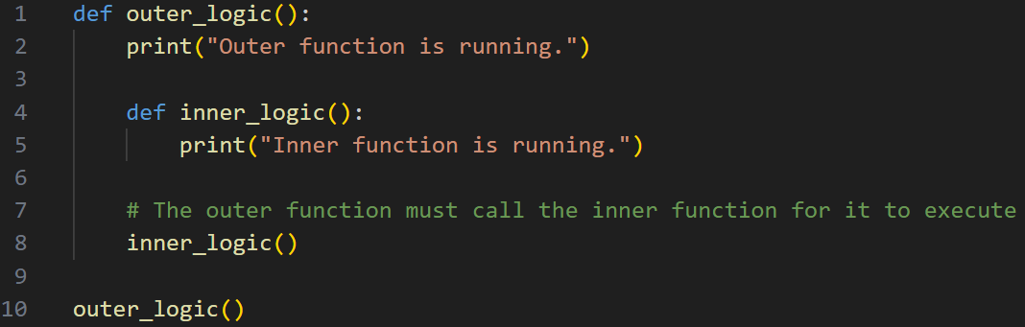
Practical exercise 05
Lab Task 5 – Inner/Nested Functions
*

Slide 16
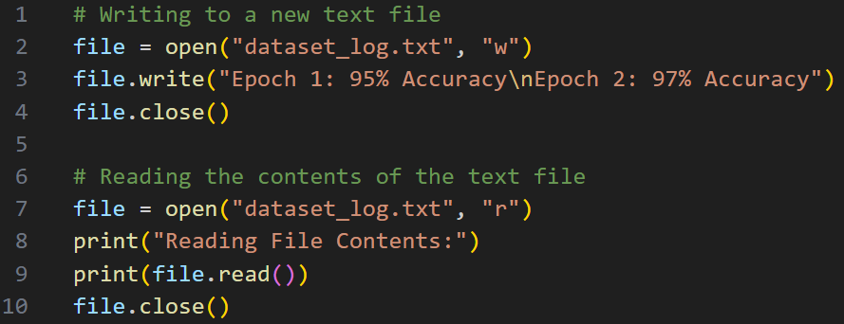
Practical exercise 06
Lab Task 6 – File Handling
*

Slide 17
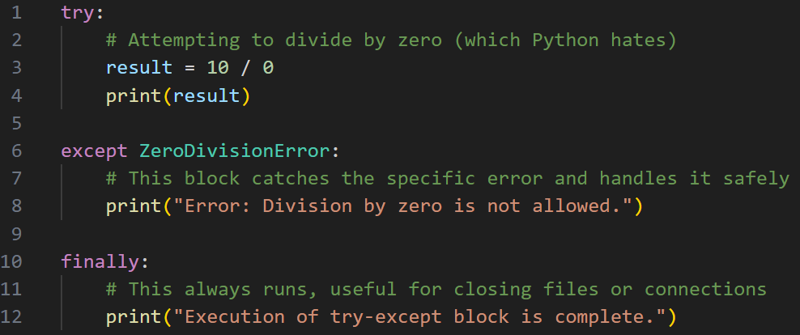
Practical exercise 07
Lab Task 7 – Exception Handling
*

Slide 18
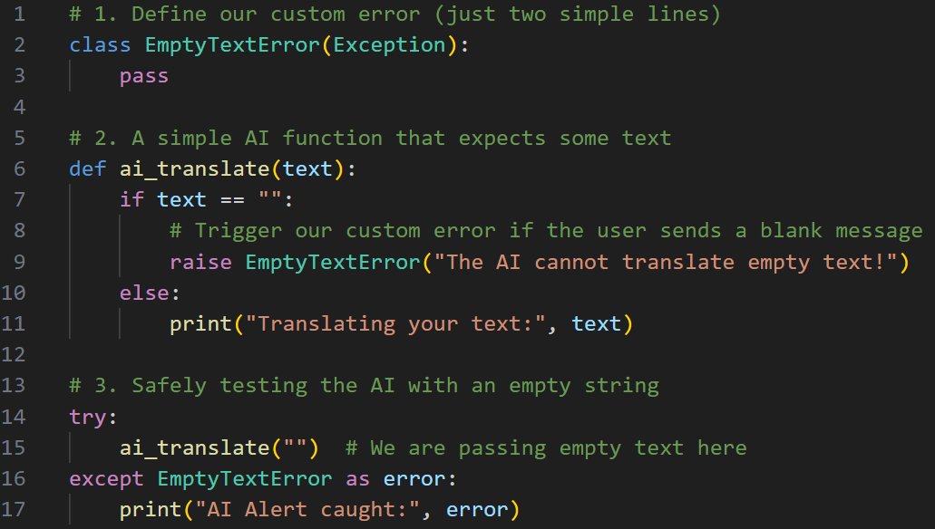
Practical exercise 08
Lab Task 8 – User-Defined Exception Handling
*

Slide 19
Thank You for Your Focus Today!
What was the most confusing part of today's lab?
Waleed Khan (Robotics Engineer | Senior Python Developer)
Email: 0xcloudcoder@gmail.com Contact: +923126008702
}
*

